Slide 1
ELL Overview and Strategies
Waianae High School
Saofai Lowe, ELL Coordinator
Sherry Ann Chang ELL RT
January 23, 2015

Slide 2
Objectives
Provide an understanding of the English Language Learner Program Identification and Referral Process
Introduce WIDA ACCESS and WIDA English Language Proficiency Standards and English Language Proficiency (ELP) levels
To learn some essential strategies for differentiating classroom instruction for ELLs.

Slide 3
Identification, Assessment, and Program Placement System (IAPS) for English Language Learners Program
Includes the following steps that schools are obligated to follow for ELL students:
Identification
Assessment
Program placement and instruction
Assessment, reassessment, recategorization, exiting, and monitoring of ELL students from program services into the mainstream education program

Slide 4
Identification
Student is a “K” Potential ELL if any Language Other Than English is Marked on the Student Enrollment Form (SIS-10W) or on a Home Language Survey (HLS).
Referral via Home Language Survey
Languages were not filled out correctly or a regular education teacher can refer a student

Slide 5
Assessment
W-APT (WIDA ACCESS for ELL Placement Test)
State approved initial English language proficiency assessment
Parent consent is not required to test
WIDA ACCESS (Assessing Comprehension and Communication in English State-to-State for English Language Learners)
Annual Test given in mid-January to end of February

Slide 6
Categorization
NEP - Non English Proficient (1.0-2.7 Overall)
Minimal or no proficiency in understanding and speaking English
LEP - Limited English Proficient (2.8-4.7 Overall)
Functionally proficient in understanding and speaking English, but limited in reading and writing skills
FEP – Functionally English Proficient (4.8-6.0 Overall);
4.2 Literacy PL

Slide 7
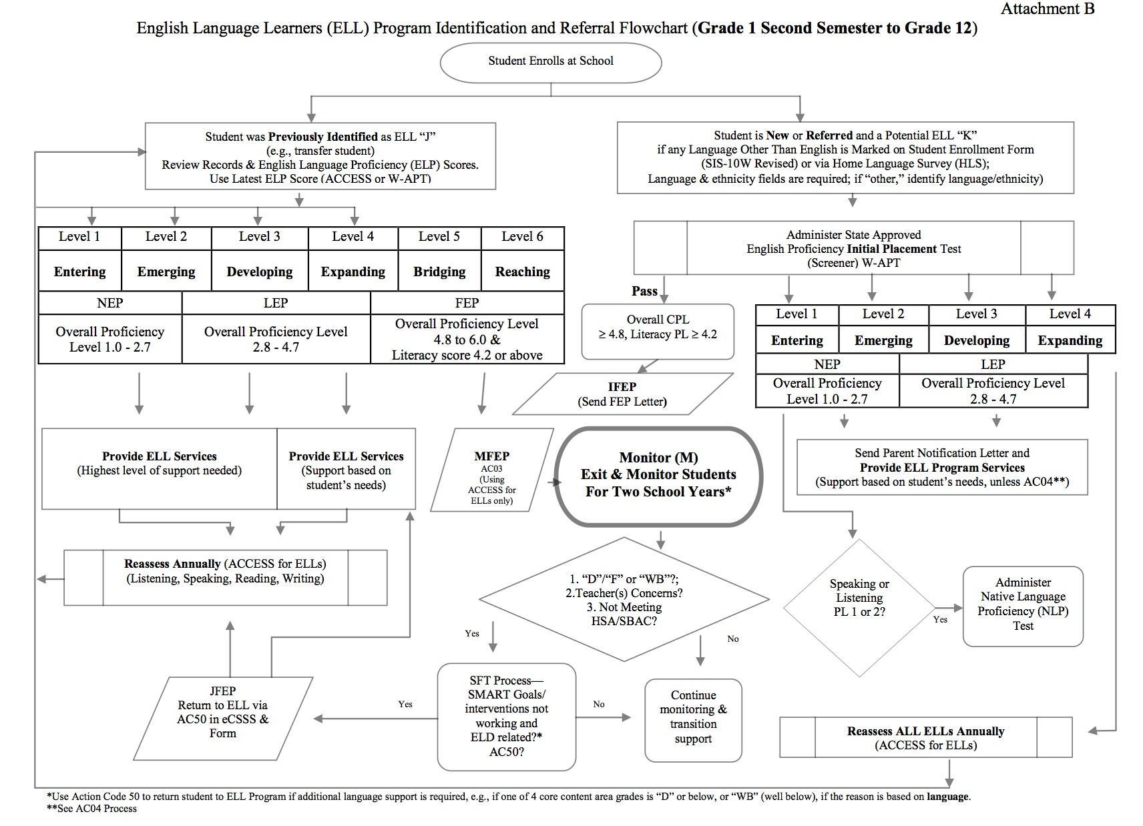
ELL Services Decision Making

Slide 8
Service Delivery
Offered to ELLs via a Language Instruction Educational Program (LIEP)
1. Sheltered English instruction
The goal is proficiency in English while learning content in an all-English setting
Instruction is adapted to students’ proficiency in English, and is supported by visual aids and first language support as available
Fully developed prototypes of this program include Sheltered Instructional Observational Protocol (SIOP) and Specially designed academic instruction delivered in English (SDAIE)
2. Structured English Immersion (SEI)
The goal is fluency in English, usually serving only ELLs in the classroom
All instruction is in English, adjusted to the proficiency level of students so subject matter is comprehensible
3. Content Area Tutoring (CAT)
The goal is fluency in English
Individual or small group tutoring is provided to ELLs during the school day for students near English proficiency
Tutoring may be in a mainstream classroom in such content areas as English language arts, math, science, and social studies
4. Pull-out English-as-a-Second Language (ESL)
The goal is to develop fluency in English
Ell students leave mainstream classroom part of the day to receive ESL instruction, often focused on grammar, vocabulary, and communication skills, not academic content.
Notes:
For Hawaii, we predominantly use the following 4 LIEP. These are scientifically research based programs.
SDAIE – Focus on secondary students learning content and language simultaneously.

Slide 9
ELL Staffing and Resources
The school is responsible to provide the necessary resources
Highly Qualified staffing
Competencies
Understanding and applying knowledge of first and second language development, literacy development, and content area learning
Using effective, teaching practices to enhance learning
Understanding and applying knowledge of cultures and cultural learning styles of English
Assessing and placing ESL students in appropriate learning settings to facilitate their development of literacy and content area knowledge
Gathering, recording, reporting, and analyzing ELL Program data

Slide 10
Stages of Second Language Acquisition Adapted from Krashen & Terrel, 1983
Stage | Preproduction | Early Production | Speech Emergence | Intermediate Fluency | Advanced Fluency
Characteristics | The student: -Has minimal comprehension -Does not verbalize -Nods “Yes” and “No” -Draws and points | The student: -Has limited comprehension -Produces one-or-two-word responses -Participates using key words and familiar phrases -Uses present-tense verbs | The student: -Has good comprehension -Can produce simple sentences -Makes grammar and pronunciation errors -Frequently misunderstands jokes | The student: -Has excellent comprehension -Makes few grammatical errors | The student: -Near-native level of speech
Approximate Time Frame | 0-6 months | 6 months-1 year | 1-3 years | 3-5 years | 5-7 years
Teacher Prompts | Point to… Show me… Circle the… Where is… Who has… (Focus on building vocabulary) | Yes/No questions Either/or questions One-or-two-word answers Lists Labels (Model and provide corrective feedback) | Why…? How…? Explain… Phrase or short sentence answers (Help expand what students say from phrase to sentence level) | What would happen if…? Why do you think…? (Help ELLs sound like a book) | Decide if… Retell… (Provide increasingly higher-level academic phrasing and vocabulary)

Slide 11
Let’s examine a student’s ACCESS for ELLs results using the
CAN DO Descriptors:
Listening 3.9
Speaking 5.3
Reading 3.6
Writing 2.9
https://www.wida.us/
https://www.wida.us/membership/states/Hawaii/index.aspx

Slide 12
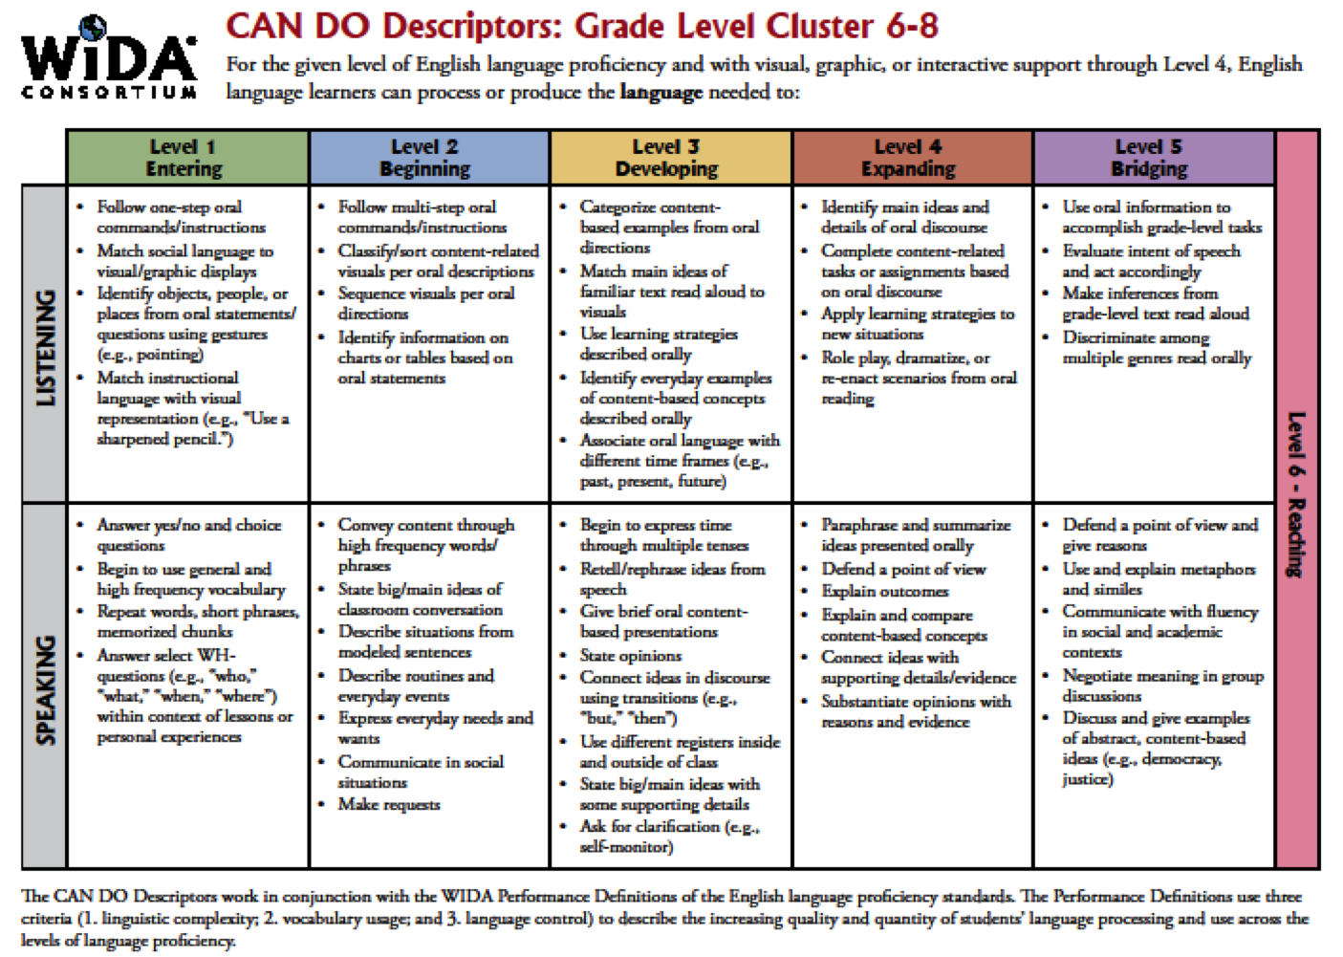
3.9
5.3

Slide 13
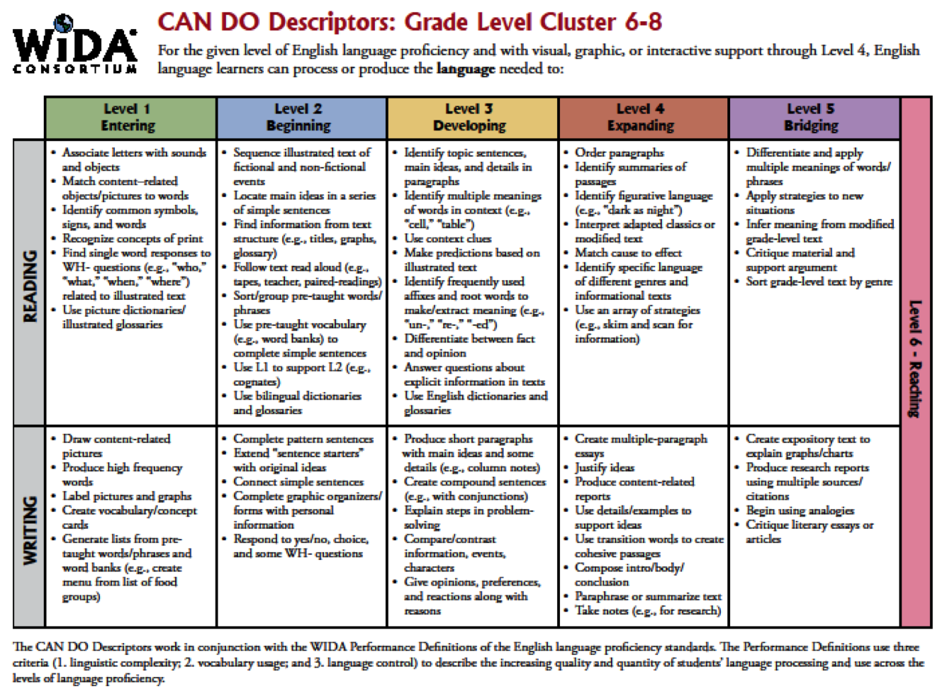
3.6
2.9

Slide 14
Transition From ELL Services
ELL students will automatically exit the ELL program in eCSSS when a student reaches a 4.8 Overall score (Reading, Writing, Speaking, Listening) with a minimum of 4.2 Literacy (Reading/Writing) PL Score.

Slide 15
Monitoring Exited ELLs
Two year (two full school years) monitoring period
EWS (Early Warning System) for Monitored ELL Student – checks to see if students are on or off track. Students who receive grades of Fs and/or Ds will show up on EWS.

Slide 16
Waianae Students Struggles
KT – “Class too noisy. Can’t focus.”
EK – “Hard time big words. Don’t understand it.”
EH - “I don’t do my work. Don’t understand the
instructions and what my teacher said.”
EJ – “Don’t know how to say the words. I read by
myself.”
FT – “Teacher talks too fast. Don’t understand the
words.”
A list of ELLs will be sent to counselors for class placement based on the ACCESS test results. A list of all ELLs will be emailed to teachers at the beginning of the school year so they know who the ELLs are in their classes.

Slide 17
Equal vs. Equality
http://themetapicture.com/equality-vs-justice/

Slide 18
Vocabulary Strategies
Fryer models
Add native language translation and definition.
Use pictures, examples, non-examples.
With new vocabulary, provide simple/kid-friendly synonyms.

Slide 19
Vocabulary Strategies
Active Involvement Techniques for
Vocabulary Development
Mind Games (James Madden)
Input
Recognition
Discrimination
Production http://tereomaori.tki.org.nz/

Slide 20
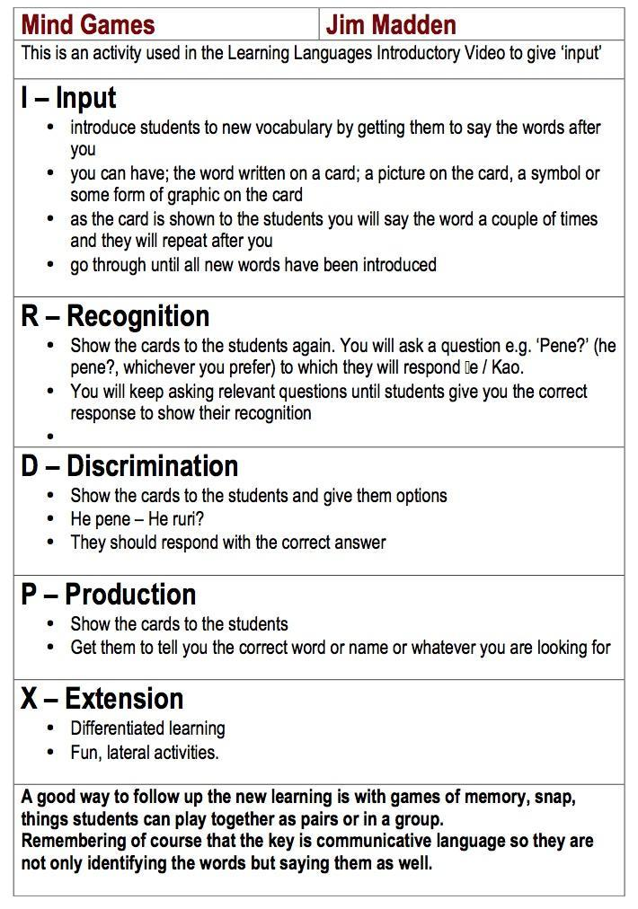
http://tereomaori.tki.org.nz/

Slide 21
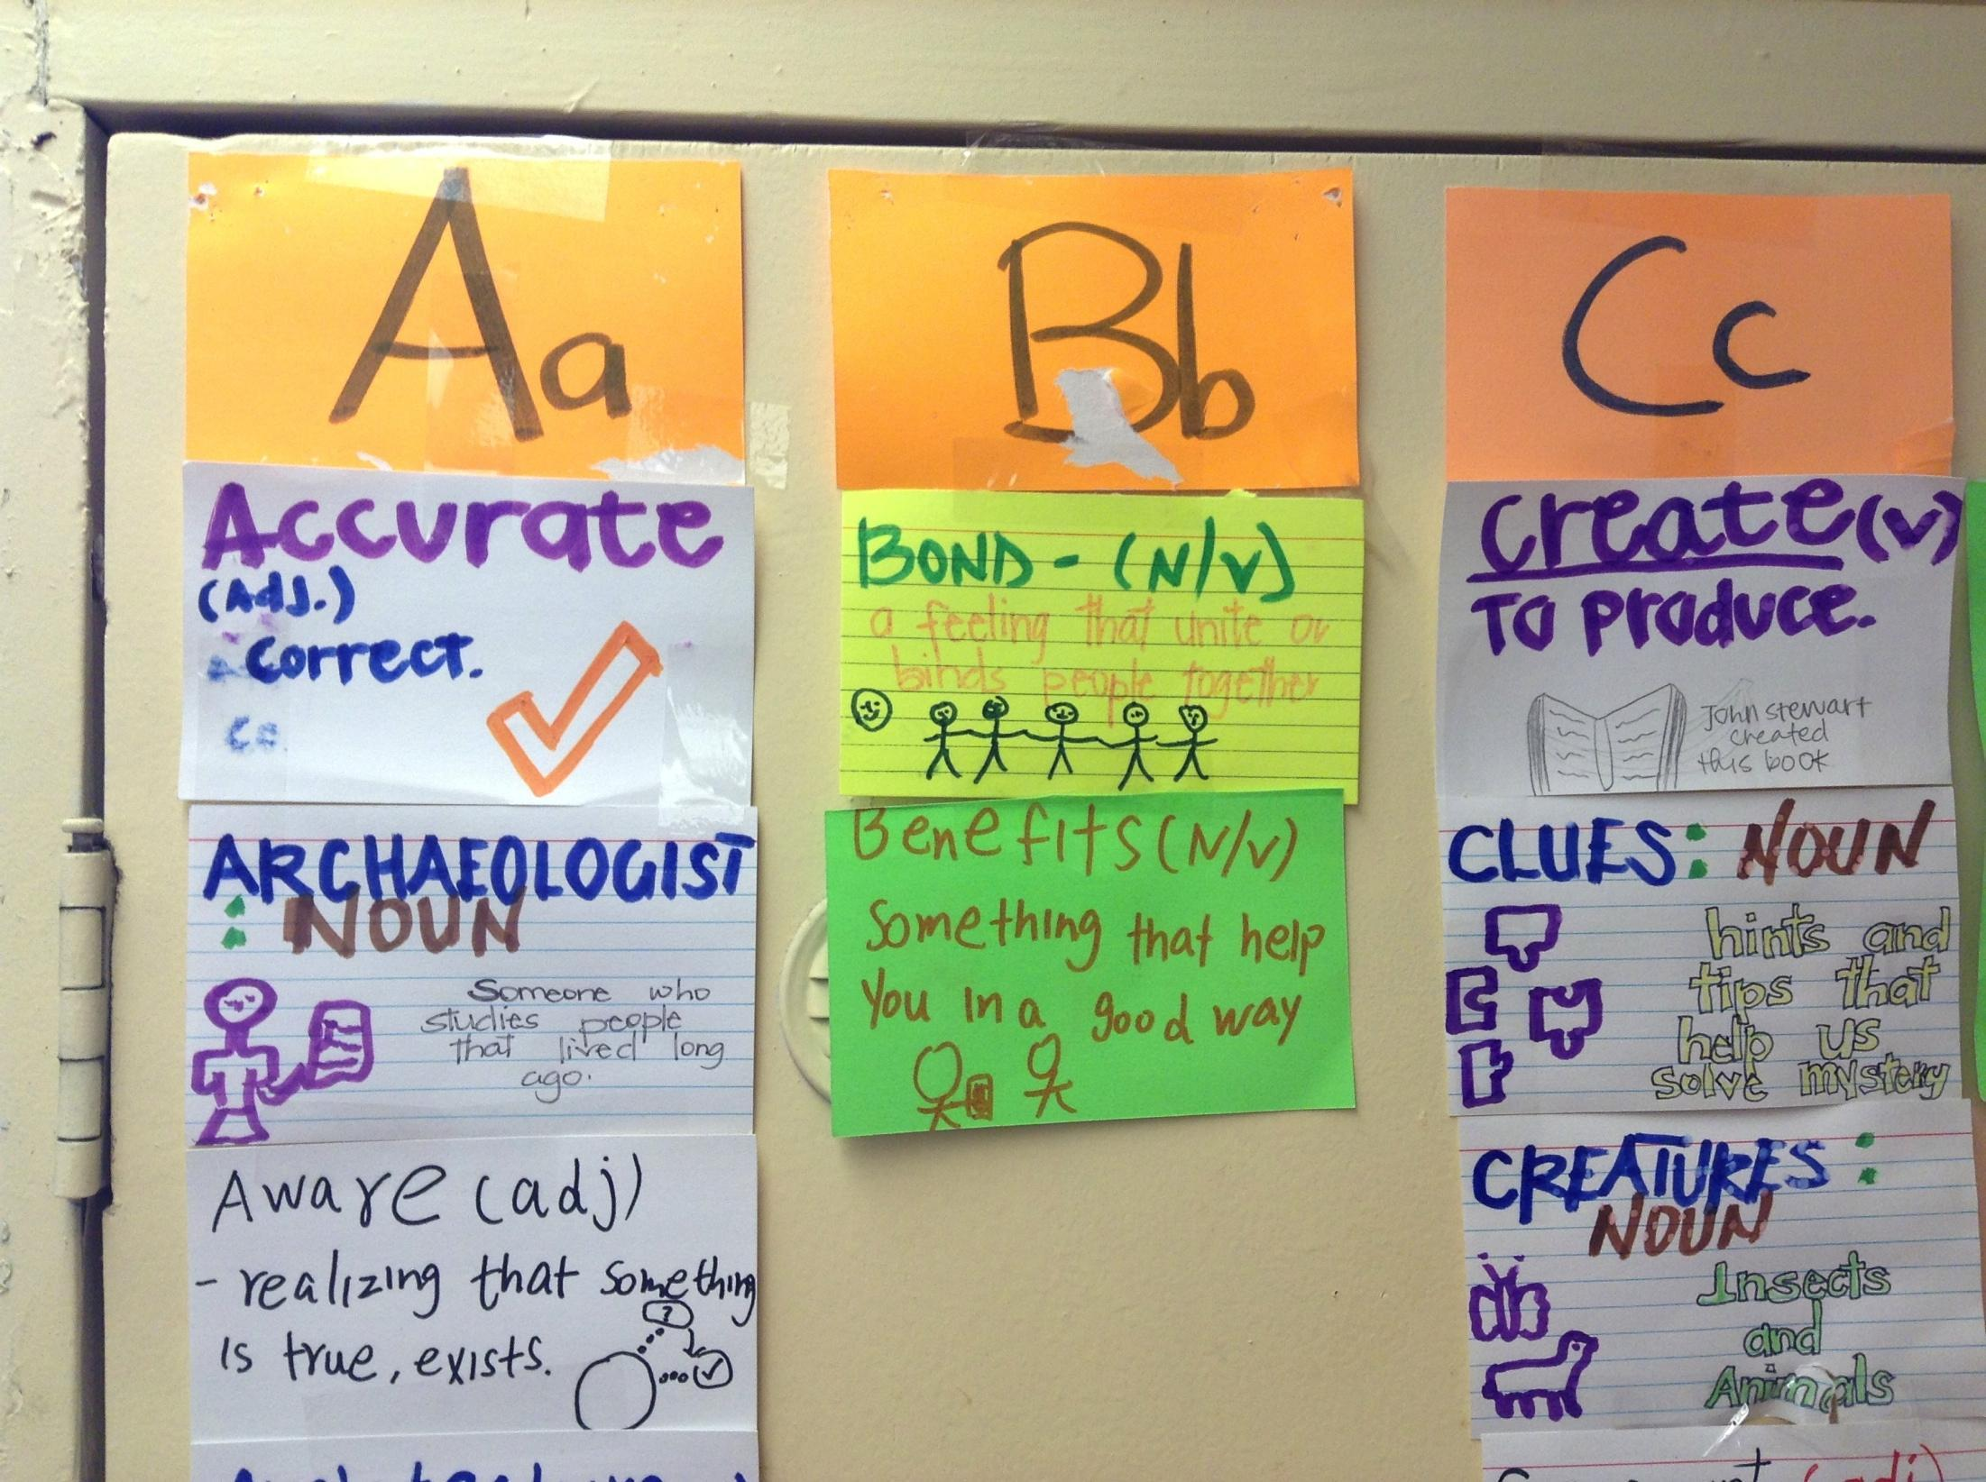
Vocabulary Strategies
Word Wall – students build it and use it with purpose
*use it in speaking every day to build their vocabulary bank

Slide 22
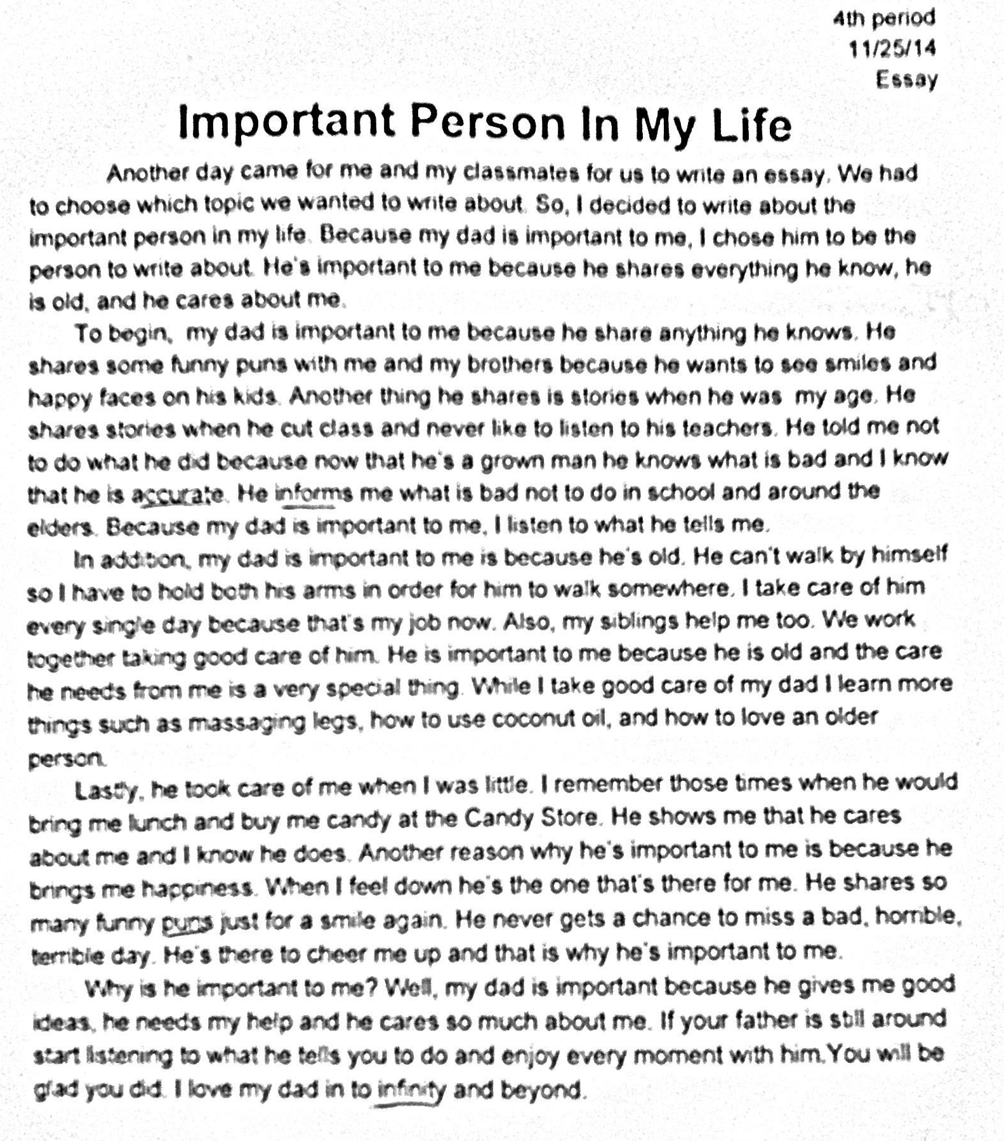
Word Wall
* use it in writing –set expectation for students to use the
words correctly; grade it (CCSS)

Slide 23
More Tips
Seat ELLs in the front of the classroom to hear and see instructions and demonstrations better
Slow down when speaking. Don’t water down the content.
Assign a buddy - nudge, explain, speak, read, be a friend
Small group - mix it up, assign a responsibility
Whole class - continue to nurture desire and language development. For example, students share written work if they can’t verbalize it; praises go a long way
Allow ELLs to present project to a teacher or small group until they are ready to do it in front of the whole class

Slide 24
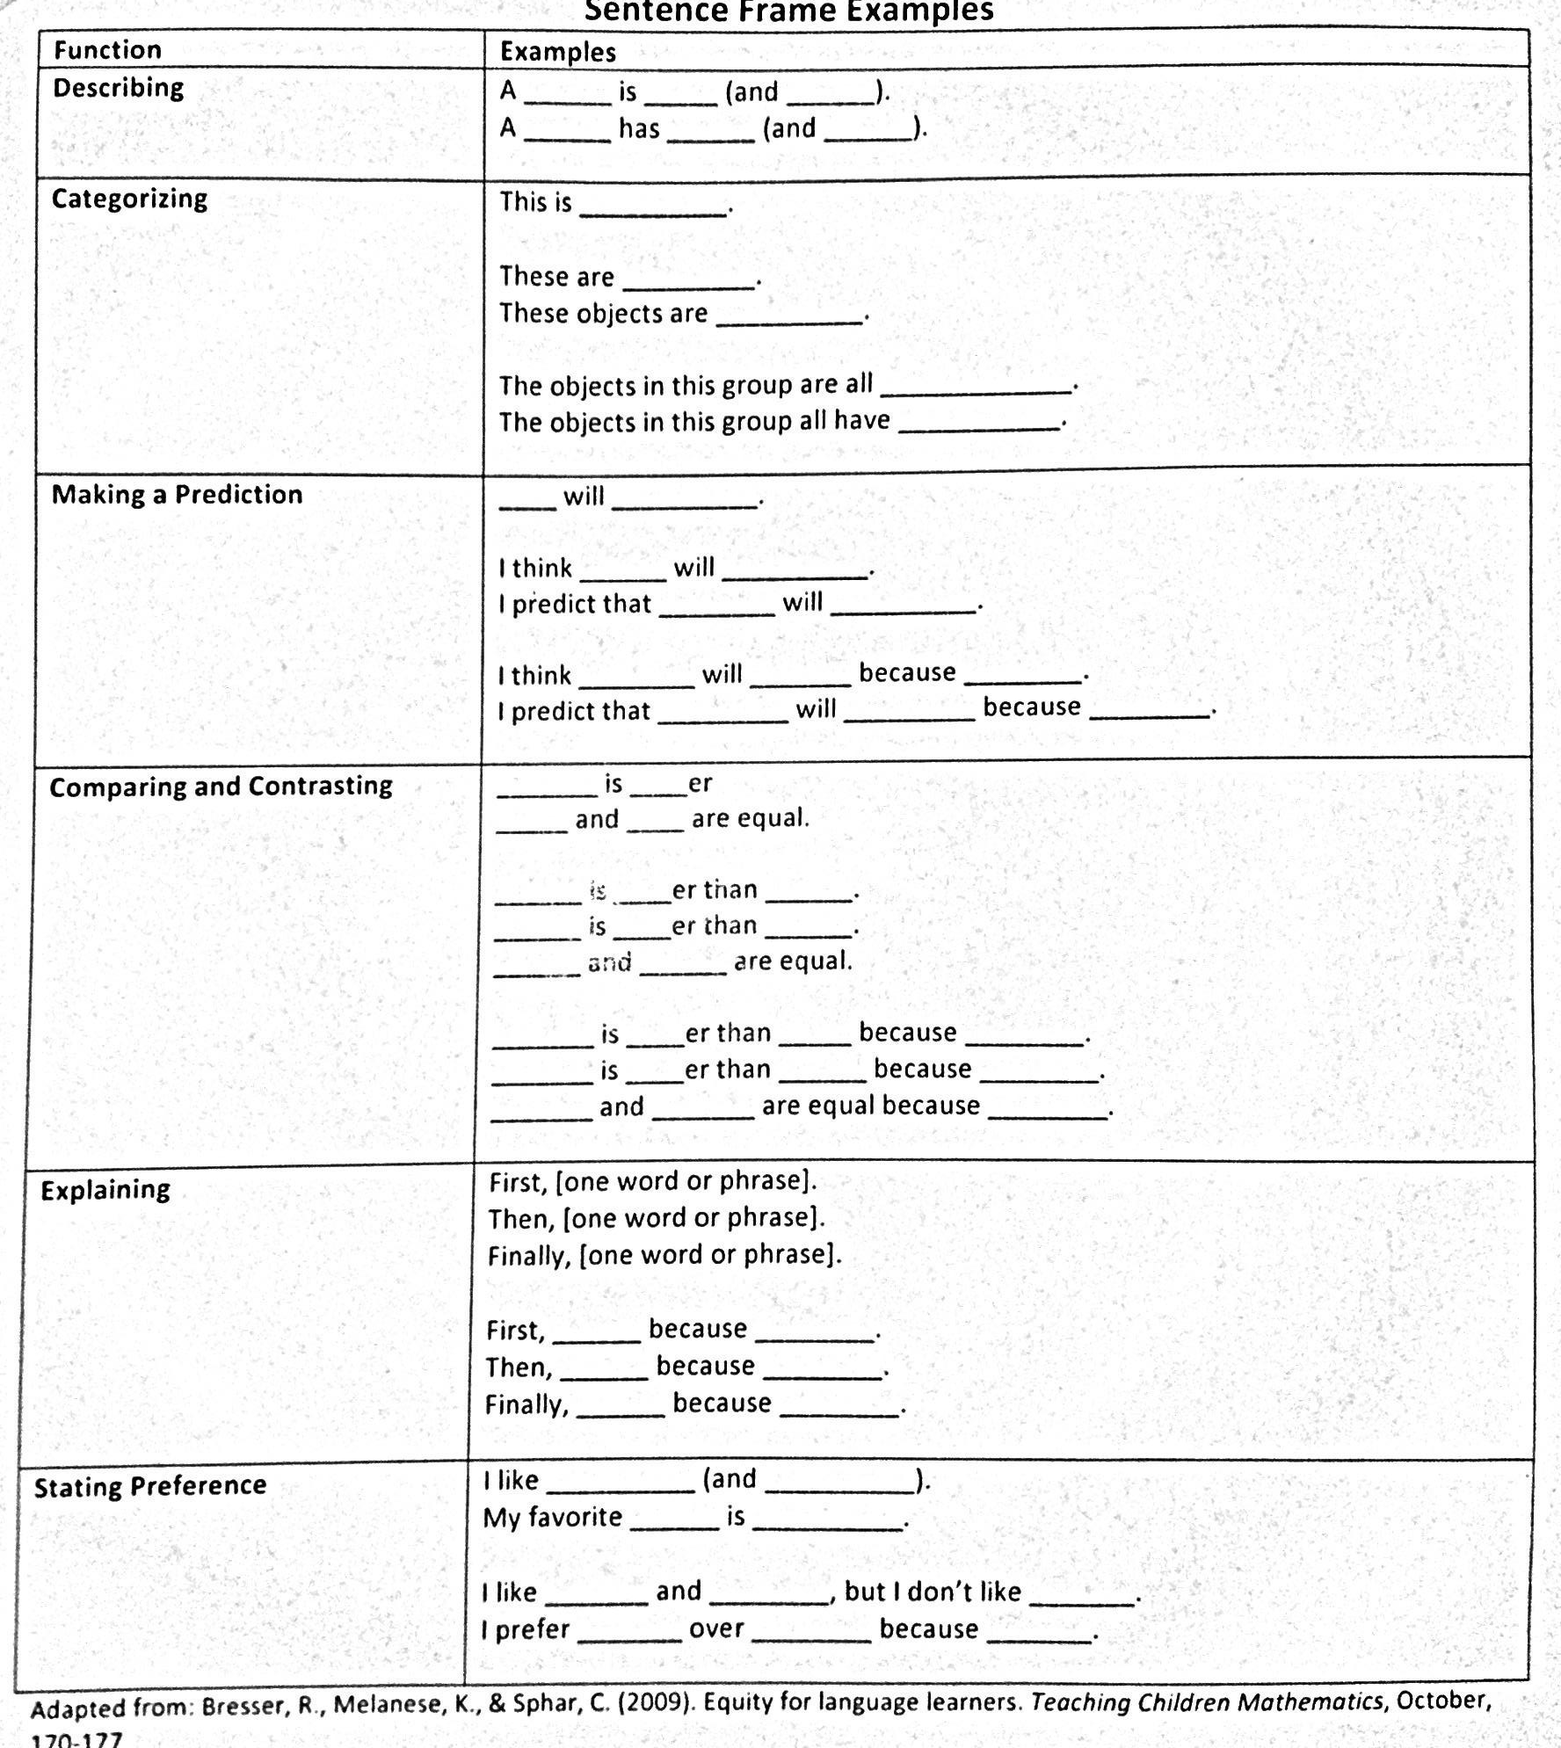
Reading & Writing Strategies

Slide 25
Reading & Writing Strategies
Paragraph Frames
Sample Math Problem-Solving Poster
Echo read, cloze end reading, peer reading, etc.
Thinking Maps – Flow Map, Tree Map

Slide 26
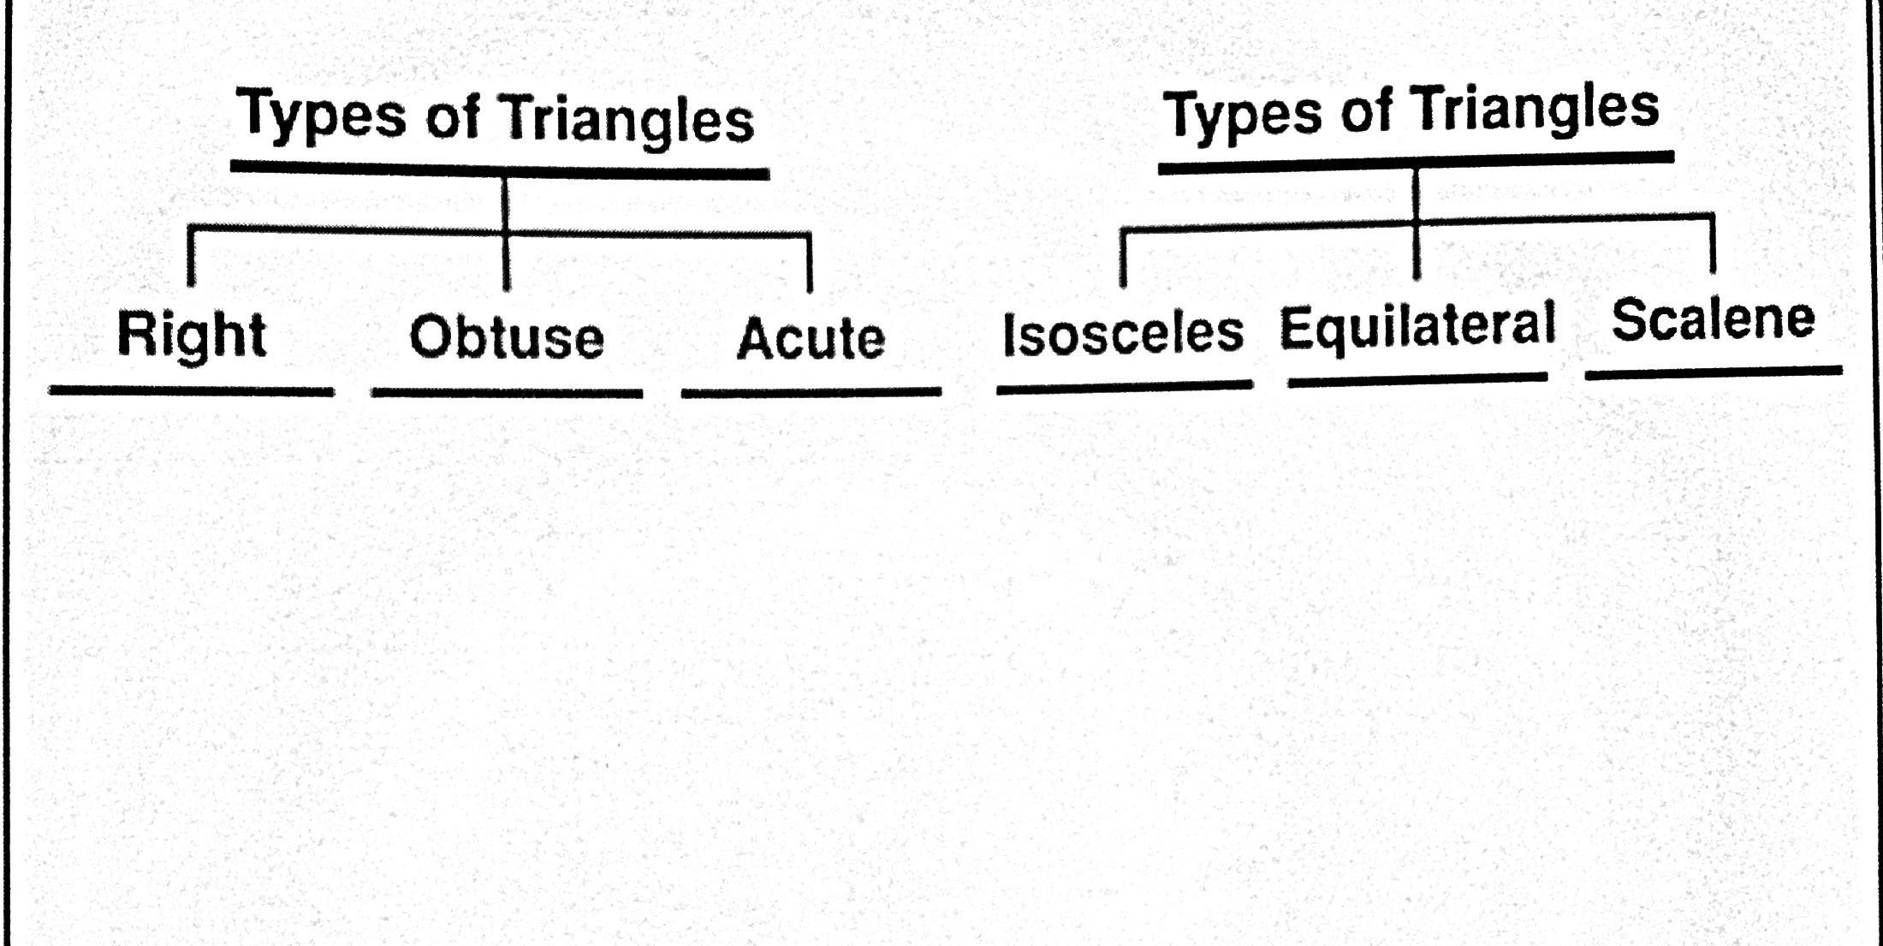
Tree Map

Slide 28
Supporting our Language Learners
Language is learned communicatively, through the process of building meaning in a collaborative context. To make use of this understanding about language learning, keep the following points in mind:
Second language learners utilize their knowledge of their first language in learning their second
Language learning is supported through meaningful interaction, which should therefore focus on the communicative functions of language
Language learners require comprehensible 'input' that serves as a model of what they are to learn

Slide 29
Supporting our Language Learners
During teaching, this comprehensible input should be 'scaffolded' (i.e., used iteratively to support the interaction, and gradually withdrawn as students become adept), in order to provide an effective communicative environment that is salient to the learner
Any focus on grammatical form should serve communicative needs
There is no one best theory to explain second language acquisition. Teaching methodologies driven by varying theoretical approaches can be effective in the classroom, depending on the material being presented, the goals of the lesson, and the target students
How quickly students progress through the stages depends on many factors, including level of formal education, family background, and length of time spent in the country
Notes:
Dr. Rosamina Lowi, UCLA Department of Applied Linguistics
Basic Principles of Foreign Language Learning
http://www.lmp.ucla.edu/k-12/tools_principles.aspx

